Slide 1
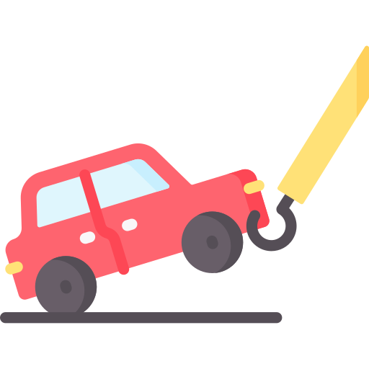

Tow Mater
Third review
+ Martin Chéliz
+ Laura Mendes
+ Samantha Gorrin
+ Alexis Pierre Dit Lambert
+ Imane El Khamlichi
+ Léonie Hatte
Notes:
LEONIE

Slide 2




Table of content
The final product
Release vision
Third release
Demonstration
Tests
Sprint evaluation
Time Schedule
Next Sprint
Demonstration
Tests
Notes:
LEONIE

Slide 3
Part 1 : The product
Notes:
LEONIE/IMANE

Slide 4
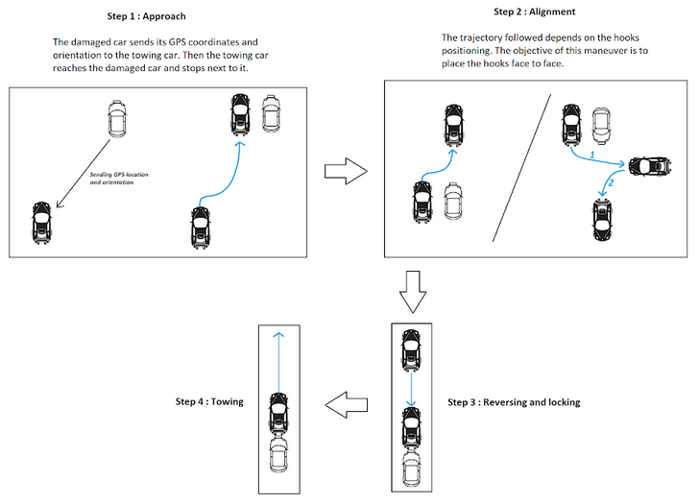
The final product
1
Sending GPS coordinates and reaching the damaged car
2
Maneuvering to place the hooks face to face
3
Reversing and locking
4
Towing
Performing the alignment maneuver and towing the car
Detecting and avoiding obstacles
Communicating with damaged car
Reaching the damaged car
Notes:
IMANE

Slide 5
Release vision
Sprint 4
Sprint 2
U-turn
Identifies moving obstacles
Stops when moving obstacles
Avoids fixed obstacles during alignment maneuver
The vehicles communicate
Reaches the damaged car
Performs the alignment
Follows a straight line
Locks the hook
Detects large obstacles
Speed regulation
No U-turn
Detects small obstacles
Identifies the car
Tows in a straight line
Sprint 1
Sprint 3
Sprint 5
Notes:
MARTIN

Slide 6
Third release
Léonie
Alexis
Martin
Imane
Samantha
Laura
29/11
06/12
13/12
Time
Higher Priority
Lower Priority
Line up with the damaged car
Get the QR code distance
1
Automatic alignment
8
Implement the U-turn trajectory
8
Identification of an obstacle
Detecting small or big moving obstacles
3
Get obstacle width and position with the Lidar
20
Notes:
IMANE

Slide 7
Part 2 : The demo
Notes:
IMANE/SAMANTHA

Slide 8

Demonstration
Following a predefined trajectory with a U-turn
Detecting small or big moving obstacles
Aligning with the damaged car
Getting QR code distance and position
Towing the car on a straight line
Notes:
SAMANTHA
8

Slide 9
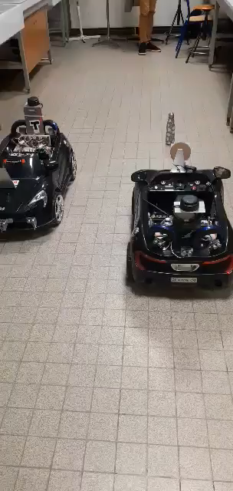
Tests (1/5)
Maneuver in a 5m radius
Following a predefined trajectory with a U-turn
Detecting small or big moving obstacles
Maximum 10 cm drift from trajectory
IDLE
Stops 75 cm +/- 5 cm away from obstacle
MANUAL MODE
EMERGENCY
Stops in less than 5s
MOVE
HOOK
Notes:
ALEXIS + Laura au clic du diapo

Slide 10
Tests (2/5)
Following a predefined trajectory with a U-turn
IDLE
MANUAL MODE
EMERGENCY
MOVE
HOOK
Notes:
ALEXIS + Laura au clic du diapo

Slide 11
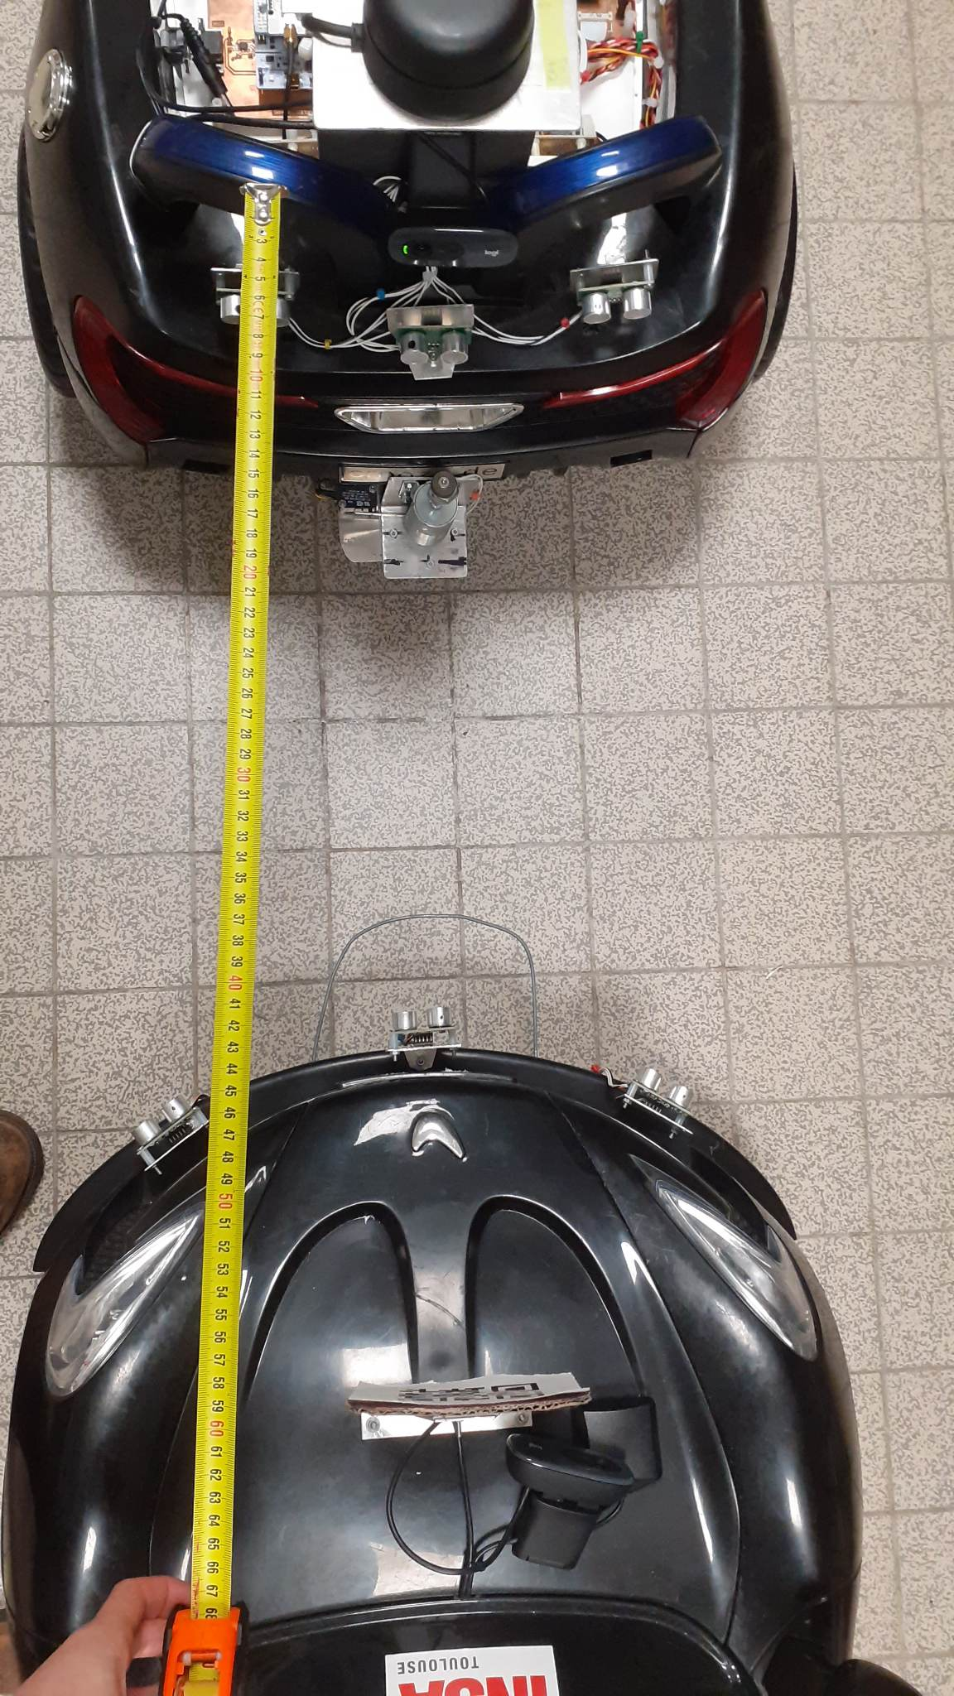
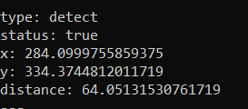
Tests (3/5)
Distance
+/- 10 cm
Getting QR code distance and position
Position
+/- 3 cm
Distance between 20cm and 100cm
Notes:
ALEXIS + Laura au clic du diapo

Slide 12
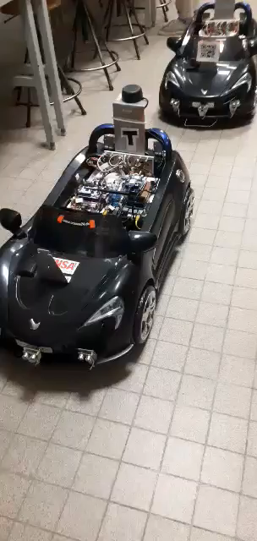
Tests (4/5)
Maximum 5 cm unalignment
Aligning with the damaged car
IDLE
MANUAL MODE
EMERGENCY
MOVE
HOOK
Notes:
ALEXIS + Laura au clic du diapo

Slide 13
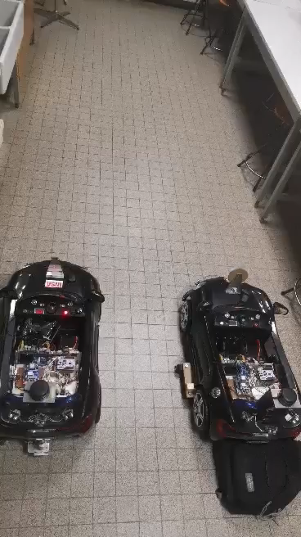
Tests (5/5)
Autonomous towing
Towing the car on a straight line
Tow the damaged car on a minimum 2m straight line
IDLE
MANUAL MODE
EMERGENCY
MOVE
HOOK
Notes:
ALEXIS + Laura au clic du diapo

Slide 14
Part 3 : The analysis
Notes:
ALEXIS / LEONIE

Slide 15


Sprint evaluation
Following a predefined trajectory with a U-turn
Detecting small or big moving obstacles
Aligning with the damaged car
Getting QR code distance and position
Towing the car on a straight line
Maximum 5 cm drift from trajectory
Obstacle width and position
+/- 5 cm
Maximum 5 cm interval
Distance
+/- 10 cm
Autonomous towing
Maneuvering in a 5m radius
Stops 75 cm +/- 5 cm away from obstacle
Position
+/- 3 cm
Tow the damaged car on a minimum 2m straight line
Stops in less than 5s
Distance between 20cm and 100cm
Identification of the obstacle after 5s
Notes:
LEONIE
15

Slide 16
Time Schedule
Léonie
Alexis
Martin
Imane
Samantha
Laura
29/11
06/12
13/12
Time
Higher Priority
Lower Priority
Line up with the damaged car
Get the QR code distance
2
Automatic alignment
8
Implement the U-turn trajectory
8
Identification of an obstacle
Detecting small or big moving obstacles
3
Get obstacle width and position with the Lidar
20
Notes:
LAURA
Thank you Léonie for this evaluation of the technical aspects. Let’s now talk about the team organization. Ineed, Here is the time organization and task repartition we planned. S now I Will explain the modifications we made to be able to validate the previous technical aspects.

Slide 17
Time Schedule
Imane
Samantha
Laura
29/11
06/12
13/12
Time
Higher Priority
Lower Priority
Get the QR code distance
Automatic alignment
Implement the U-turn trajectory
Reduction of the priority level
Detecting small or big moving obstacles
Get obstacle width and position with the Lidar
20
20
Get obstacle width and position with the Lidar
Notes:
LAURA

Slide 18
Time Schedule
Léonie
Imane
29/11
Laura
06/12
13/12
Time
ROS2 and code incompatibility
Get the QR code distance
Get the QR code distance
1
2
Automatic alignment
Implement the U-turn trajectory
Detecting small or big moving obstacles
Get obstacle width and position with the Lidar
Notes:
LAURA

Slide 19
Time Schedule
Léonie
Alexis
Martin
Laura
29/11
06/12
13/12
Time
Wait for the QR code distance
Get the QR code distance
Automatic alignment
8
Automatic alignment
8
Implement the U-turn trajectory
Detecting small or big moving obstacles
Get obstacle width and position with the Lidar
Notes:
LAURA

Slide 20
Time Schedule
Alexis
29/11
13/12
Time
Higher Priority
Lower Priority
Get the QR code distance
Automatic alignment
Implement the U-turn trajectory
Implement the U-turn trajectory
8
13
Need more time to test
Detecting small or big moving obstacles
Get obstacle width and position with the Lidar
Notes:
LAURA

Slide 21
Time Schedule
Imane
Samantha
29/11
13/12
Time
Higher Priority
Lower Priority
Get the QR code distance
Automatic alignment
Implement the U-turn trajectory
Illness of a team member
Detecting small or big moving obstacles
3
Detecting small or big moving obstacles
3
Get obstacle width and position with the Lidar
Notes:
LAURA

Slide 22
Part 4 : The plan
Notes:
LAURA/MARTIN

Slide 23
Next sprint
Imane
Samantha
Laura
Laura
Alexis
Martin
Léonie
13/12
20/12
27/12
03/01
10/01
Time
Higher Priority
Lower Priority
Detecting and avoiding obstacles
Detecting small or big moving obstacles
3
Implement the avoiding trajectory
8
Get obstacle width and position with the Lidar
13
Communicating with the damaged car
Configurate the communication…
between the two cars
13
Send GPS coordinates to the towing vehicle
8
Get the GPS coordinates of the damaged car
8
Notes:
MARTIN

Slide 24
Next sprint
13/12
20/12
27/12
03/01
10/01
Time
Higher Priority
Lower Priority
Detecting and avoiding obstacles
Implement the avoiding trajectory
8
Detecting small or big moving obstacles
3
Samantha
Alexis
Léonie
Laura
Imane
Get obstacle width and position with the Lidar
Martin
13
Communicating with the damaged car
Configurate the communication between the two cars (send ACK)
3
Get the GPS coordinates of the damaged car
1
Laura
Send GPS coordinates to the towing vehicle
1
Notes:
MARTIN

Slide 25



Demonstration
Sending GPS coordinates
Sending acknowledgement
Getting an obstacle position
Avoiding fixed obstacle
Notes:
MARTIN
25

Slide 26
Tests
Sending GPS coordinates
Sending acknowledgement
Getting an obstacle position
Avoiding fixed obstacle
Maximum 10m one from another
Maximum 10 s after receiving the coordinates
Obstacle width
+/- 5 cm
Minimum distance of 50cm
GPS coordinates +/- 0,0001 °
(≈ 50cm)
Obstacle position +/- 5cm
Maximum 20 cm drift from trajectory
Identification of a fixed obstacle after 5s
Notes:
LEONIE
26

Slide 27

Questions ?
Notes:
LEONIE

